Slide 1


Analysis of Supply Chain
Presented by :
Aly Mohamed Salama Elsharkawy
Amira Osama Abdelghany
Marina Magdy Khalaf
Ramy Albert Mouris
Sarah Hamed Abdelhakim
To
DR/ Jackie Abualeam

Slide 2
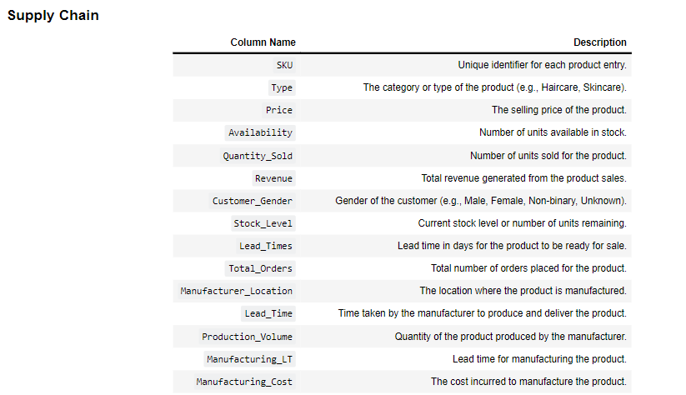

Supply Chain Dataset Description

Slide 3
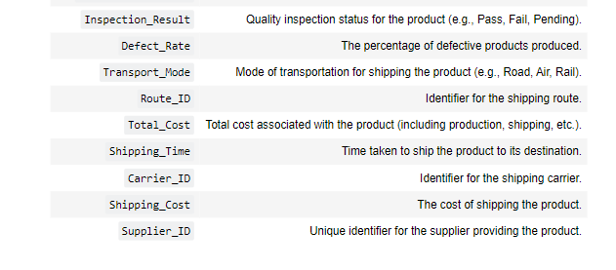
Supply Chain Dataset Description

Slide 4

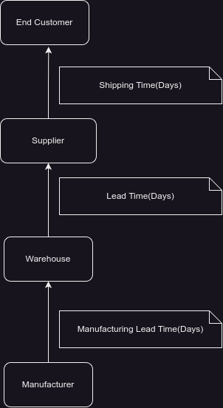
Supply Diagram
Here as we see, diagram of stages of arrival of product to a customer
It Starts with the manufacturer to warehouse where the time between them called Manufacturing Lead Time
Form warehouse to Supplier and the time between them called Lead time
And finally to the Customer and the time called Shipping Time

Slide 5
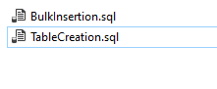
Review the SQL queries to understand the structure and analysis involved.
BulkInsertion.sql
TableCreation.sql

Slide 6
Content
Data Cleaning
Data insertion and retrieval
Data analysis and Visualization

Slide 7
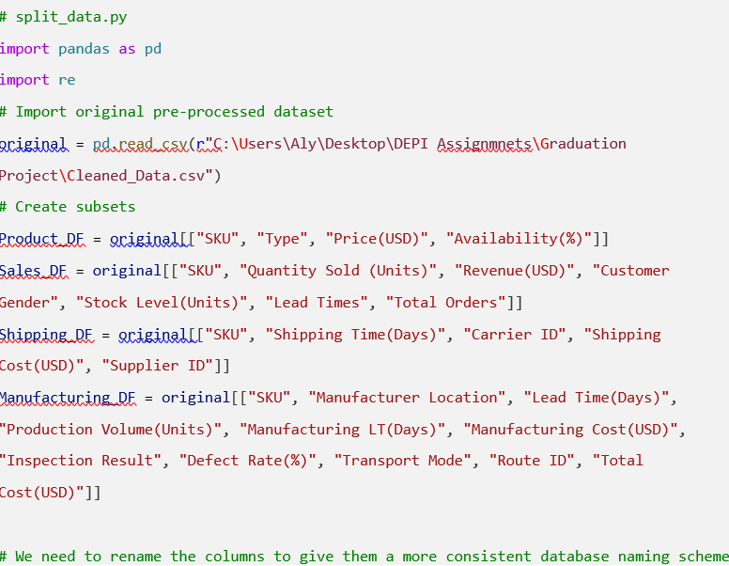
1 ) Data Cleaning
Data Cleaning had done by Python which was used for preprocessing data to understand the dataset’s numerous columns

Slide 8
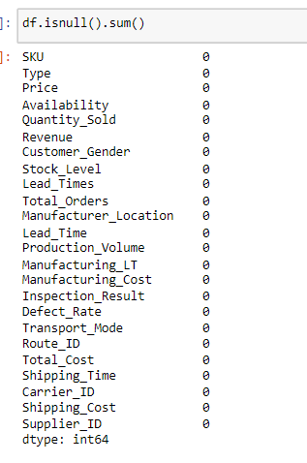
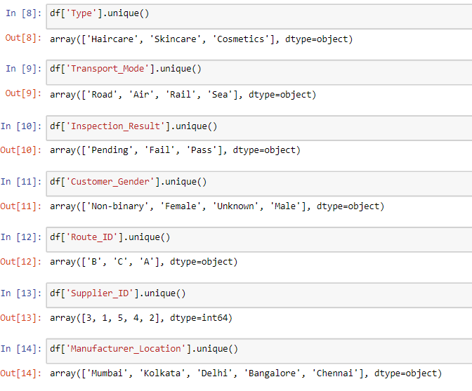

Slide 9
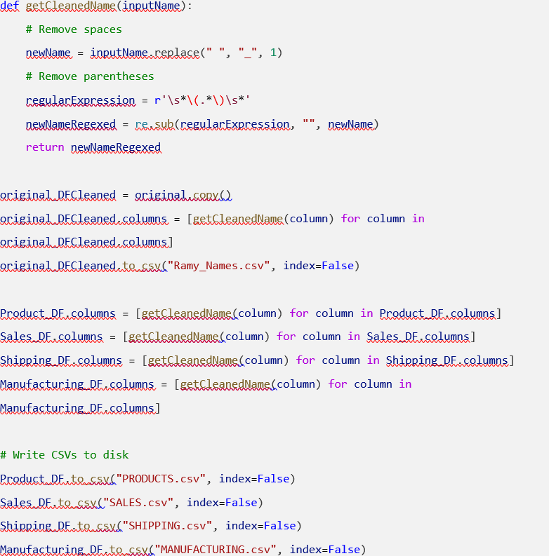
2 ) Database Insertion and Retrieval
In data insertion we first renaming the columns of the dataset in order to make the names more sensible for a database.

Slide 10

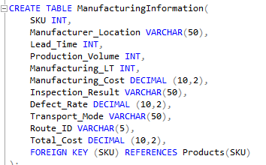
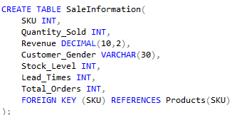

Set Up Database and Load Data
SQL Script to Create Tables:

Slide 11
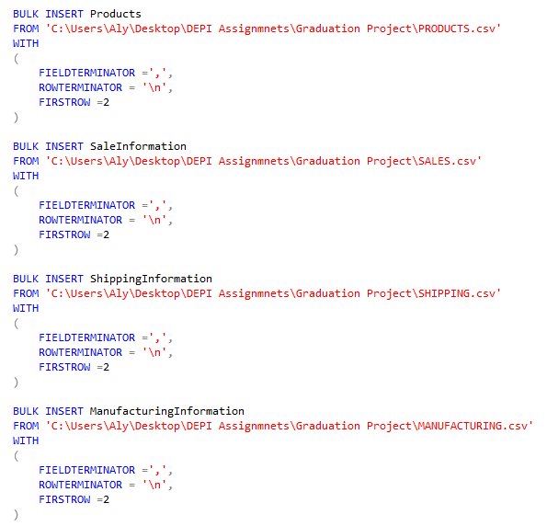
Bulk Insertion

Slide 12
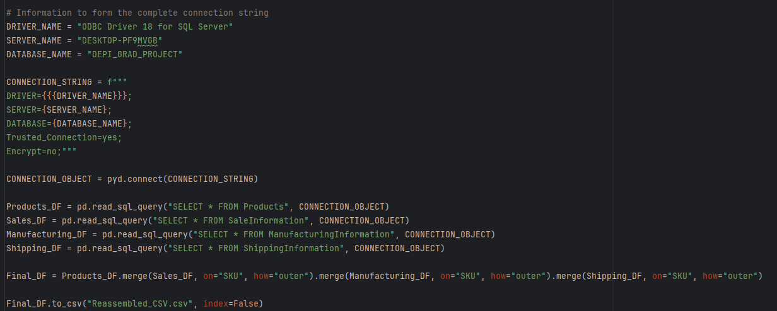

Slide 13
3) Data Analysis and Visualizations
Product-Revenue Relationship
Shipping Analysis
Stock Analysis
Customer Analysis
Manufacturer Analysis

Slide 14
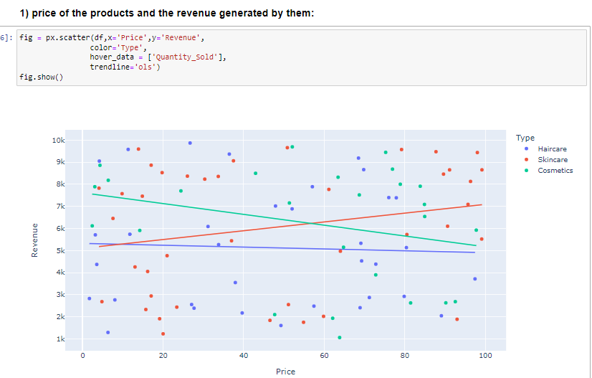

Slide 15
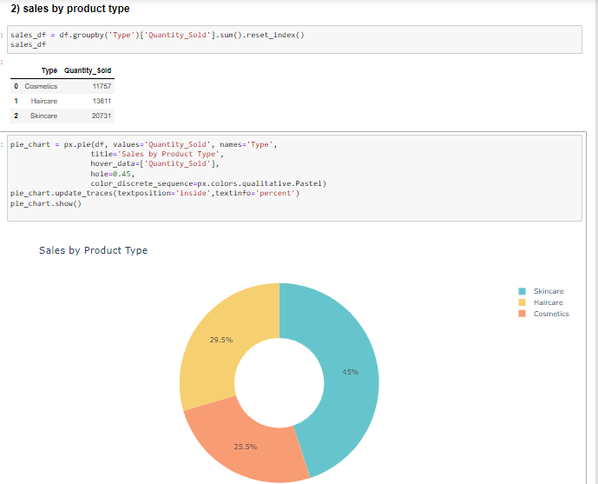

Slide 16
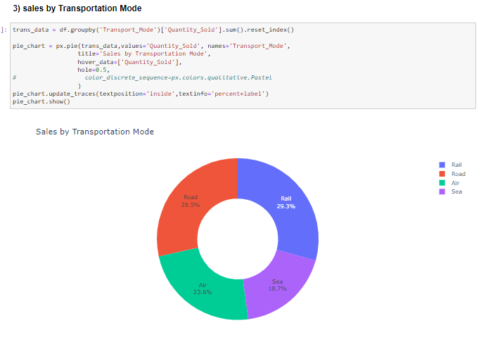

Slide 17
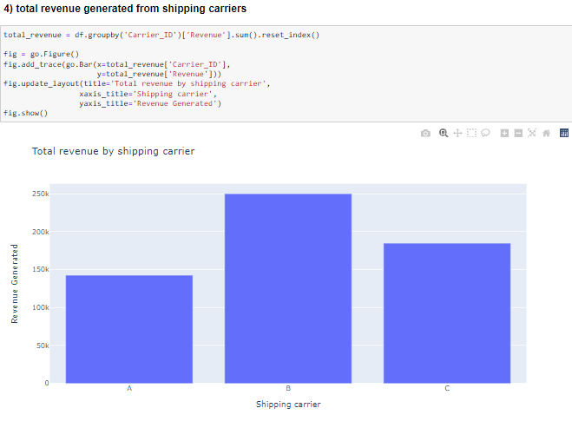

Slide 18
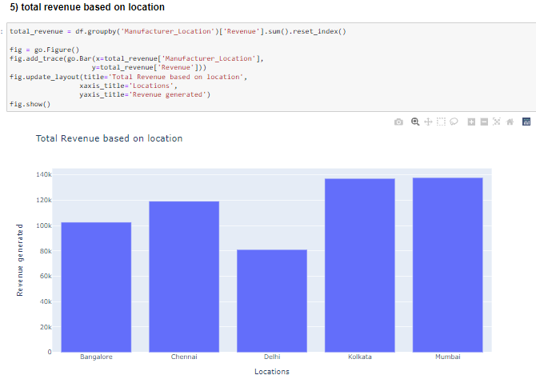

Slide 19
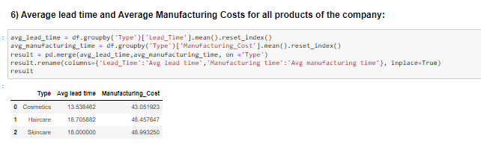
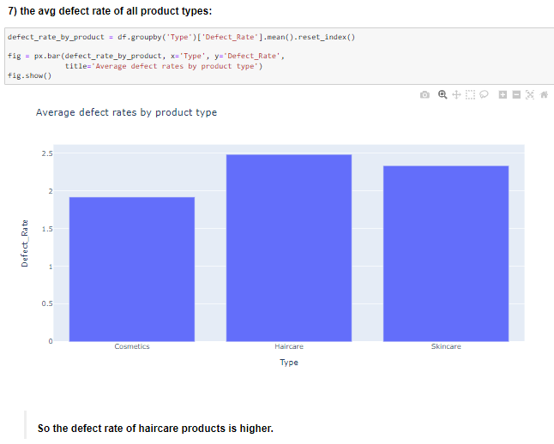

Slide 20
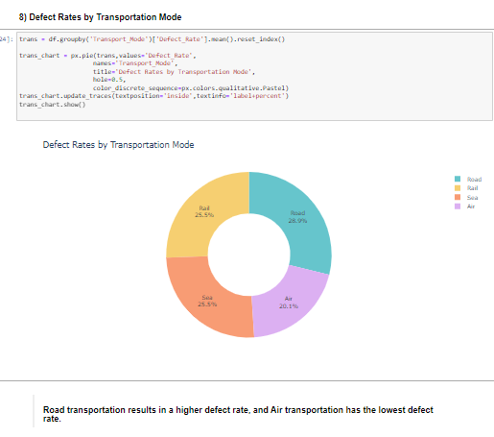

Slide 21
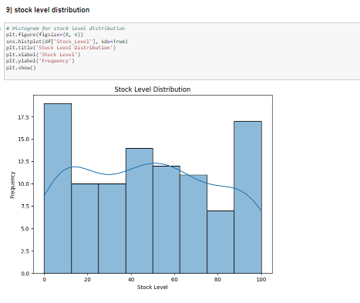
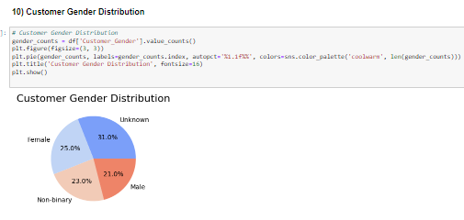

Slide 22
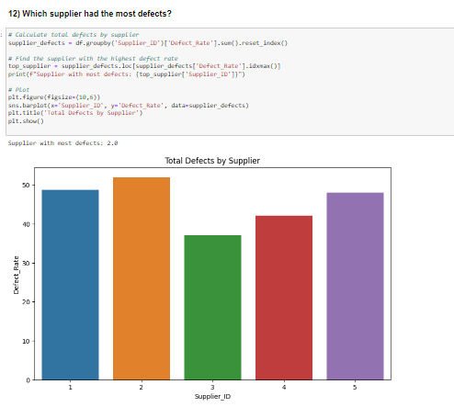
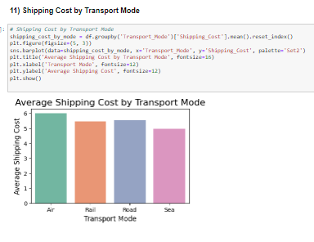

Slide 23
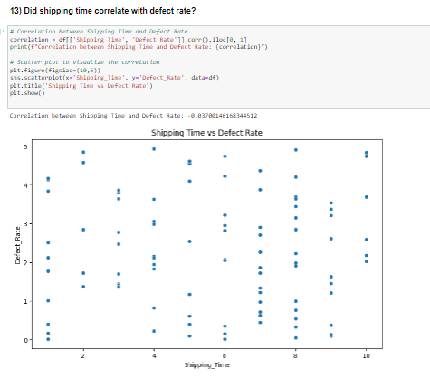
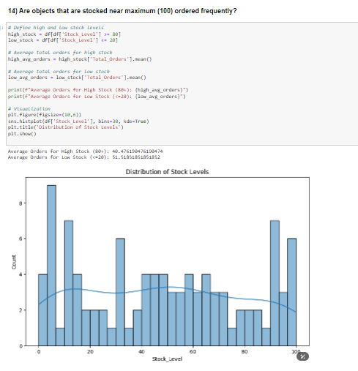

Slide 24
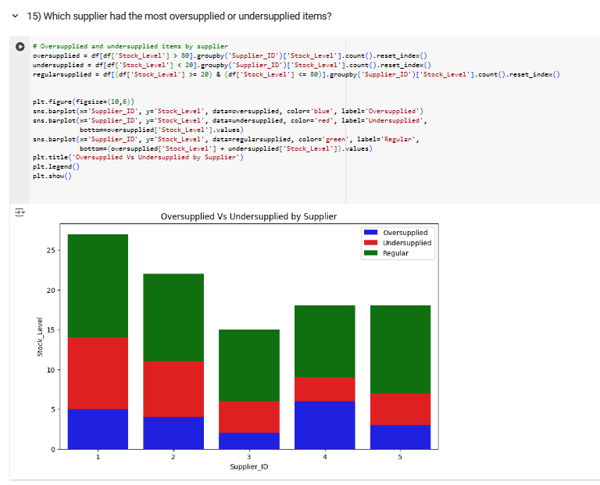

Slide 25
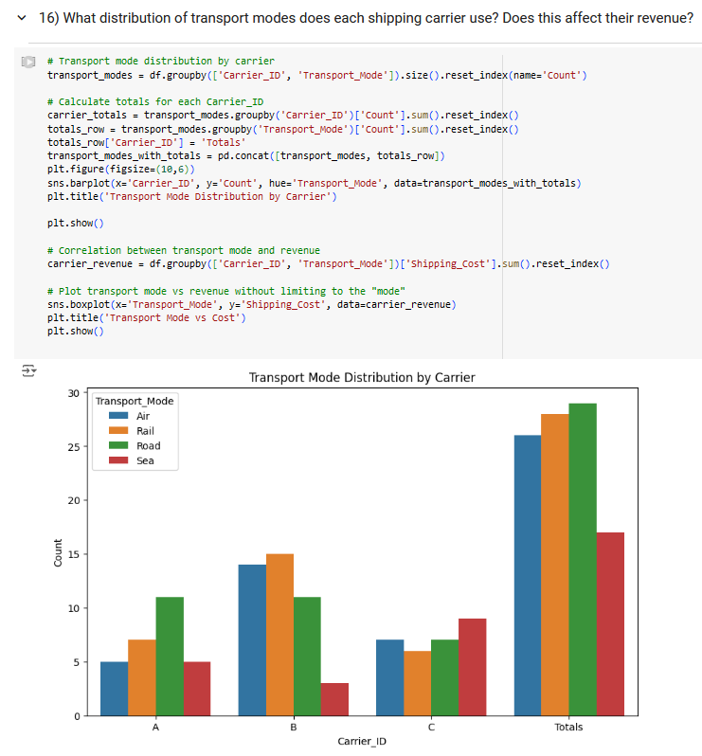
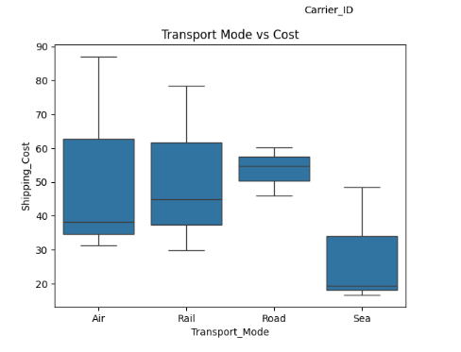

Slide 26
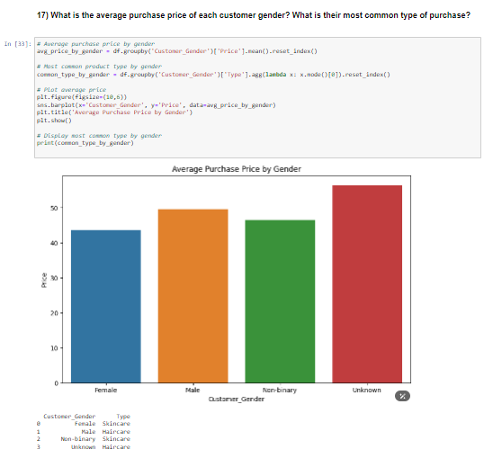

Slide 27
THANK YOU

